Slide 1
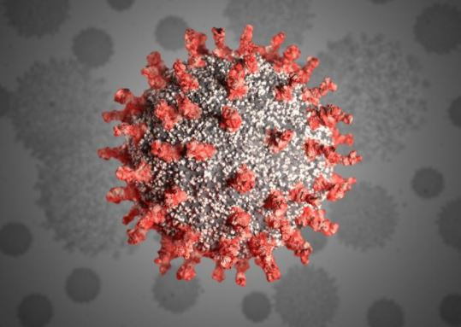
RESEARCH PROJECT ON COVID19
SQL PROJECT
-BY Sudipta Ghosh

Slide 2
contents
DATAbaseS
Objectives
Table analysis
PEOPLE GET INFECTED GENDERWISE
COMPARE OF GETTING INFECTED BETWEEN BOYS AND GIRLS where age<20 and age>50
MAXIMUM DETECTED CITY, STATE AND DISTRICT BY COVID19
PEOPLE INFECTED BY COVID19 IN DIFFERENT CITY
NAtionality
CURRENT STATUS OF THE INFECTED PEOPLE
PROBABLITY of being infected is more when people comes from outside of India
Total cases in DIFFERENT STATE WITH THEIR CITEIS
Containment ZONE
TWEETS AND HASHTAGS during pandemics

Slide 3
DATABASE
This database consists of 3 tables.
The database consist of people their nationality, infected rate in India on MARCH 2020.
The database consists of the Containment Zone in India
The database consists of the tweets by eminent personality during this pandemics.

Slide 4
OBJECTIVES
Analyse the table for the given time period
Publish the query based on the data (output)

Slide 5
TABLE ANALYSIS
For analysing the table various factors should be listed out and imported them in the table
Here we created three table and start the query by analysing them with the help of MYSQL workbench
As per the output we reach to the decision.
The output is given below.

Slide 6
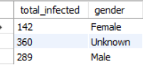
PEOPLE GET INFECTED GENDERWISE total 142 females are infected total 289 males are infected total 360 unknown gender are infected

Slide 7


COMPARE OF GETTING INFECTED BETWEEN BOYS AND GIRLS so we can see male less than 20 years has more chance to get infected as compared to female.
Female<20
Male<20

Slide 8


COMPARE AGE >50 we can see that male above 50 years are getting infected more as compared to female
Female>50
Male>50

Slide 9

MAXIMUM DETECTED CITY, STATE AND DISTRICT BY COVID19

Slide 10
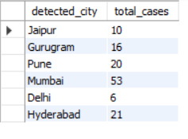
PEOPLE INFECTED BY COVID19 IN DIFFERENT CITY
Here we can see that people of Mumbai are more getting infected day by day
Chances of spreading virus in Pune and Hyderabad are also spreading.
Here is the name of the city and total cases.

Slide 11
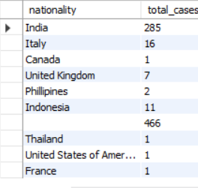
NATIONALITY
Here we can see that people are infecting by covid19 also have different nationality.

Slide 12

CURRENT STATUS OF THE INFECTED PEOPLE
Here we can see that 24 people are already recoved.
750 people are hospitalized
16 are died due to COVID19.

Slide 13
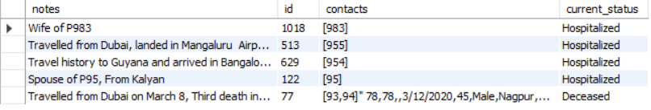
PROBABLITY of being infected is more when people comes from outside of India
It’s clearly seen that people who are travelling , coming India from abroad they are getting infeted.

Slide 14
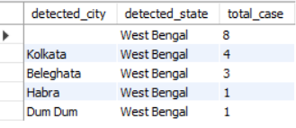
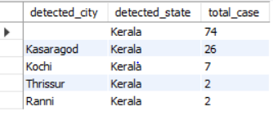
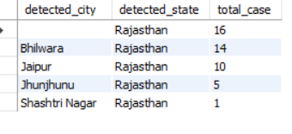
Total cases in west Bengal, Kerala, Rajasthan with their cites
West Bengal
Kerala
Rajasthan

Slide 15
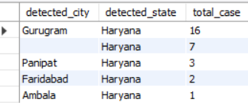
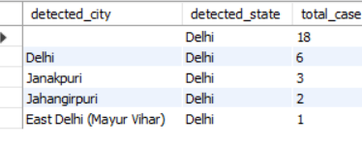
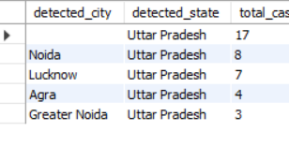
TOTAL CASES IN HARYANA, DELHI AND UTTARPRADESH WITH THEIR CITES
Haryana
Delhi
Uttar Pradesh

Slide 16
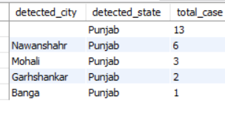
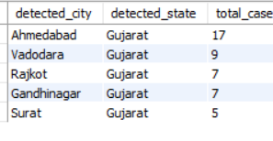
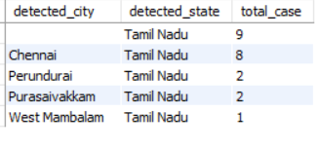
TOTAL CASES IN PUNJAB, GUJRAT, TAMIL NADU WITH THEIR CITIES
Punjab
Gujrat
Tamil Nadu

Slide 17
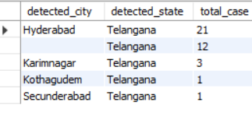
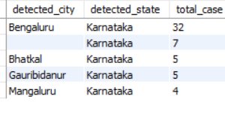
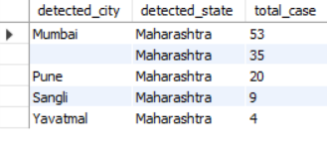
TOTAL CASES IN TELENGANA, KARNATAKA, MAHARASTRA WITH THEIR CITIES
Telangana
Karnataka
Maharastra

Slide 18
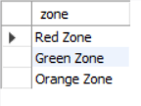
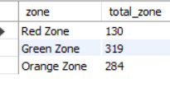
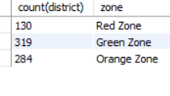
Containment ZONE
Here we can see government has separated country in three division.
Total 130 red zone,319 green zone and 284 orange zone are there
How many districts are in red zone , green zone and orange zone that is clearly seen here.

Slide 19
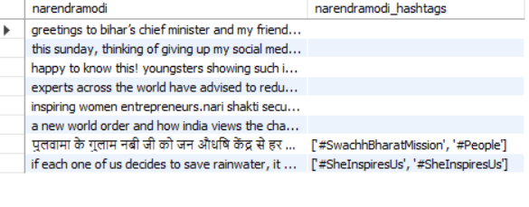
TWEETS AND HASHTAGS during pandemics
Here are PM’s TWEETS and HASHTAGS

Slide 20
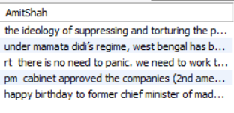
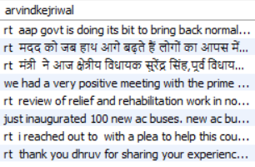
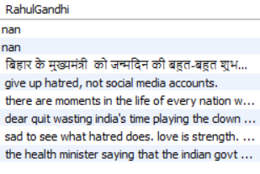
TWEETS BY EMINENT PERSONALITY
TWEETS BY AMITSHAH
TWEETS BY ARVINDKEJRIWAL
TWEETS BY RAHUL GANDHI

Slide 21


